Slide 1
Predicting NHL Playoff Success
Christopher Manley
General Assembly DSI-5
November 7, 2018

Slide 2
Motivation
“In 2015, Americans bet $149 billion illegally on sporting events.”
- http://www.visualcapitalist.com/americas-multi-billion-dollar-sports-betting-industry/
Sports gambling laws are changing
A good and accurate model would be highly useful to an NHL team
But mostly, I love hockey!

Slide 3

What is the problem?
Problem Statement:
Given regular season statistics, can a classification model be built to predict how each team will do in the playoffs?

Slide 4
The Data
Source: hockey-reference.com
Scraped regular season team and individual player statistics from 2008-2018 using BeautifulSoup.

Slide 5
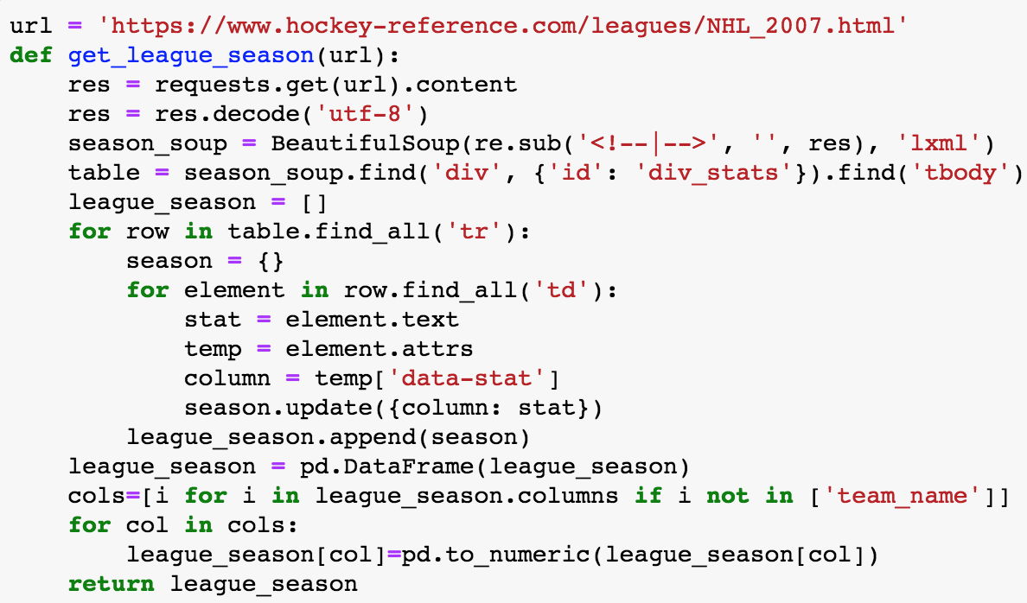
Example Scraping Function

Slide 6
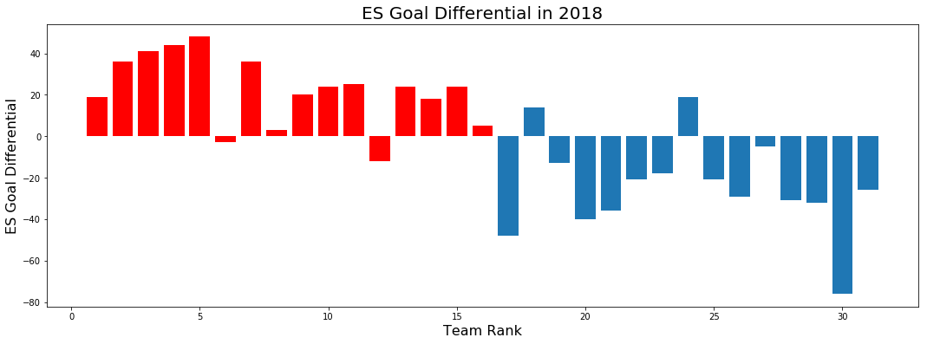
Exploratory Data Analysis
Playoff teams in red

Slide 7
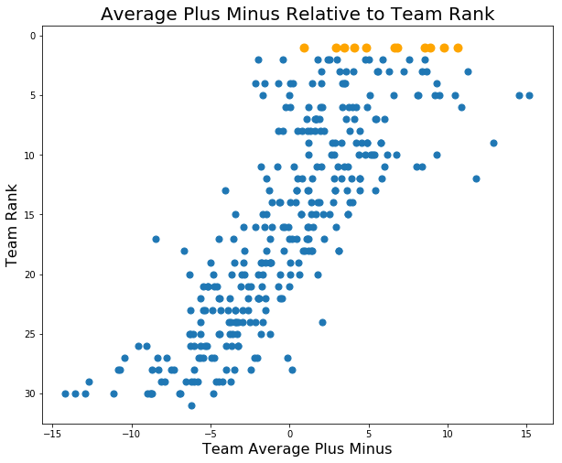
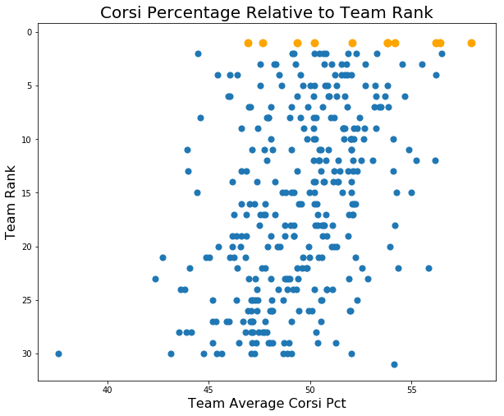
Feature Engineering
Stanley Cup winners are shown in orange

Slide 8
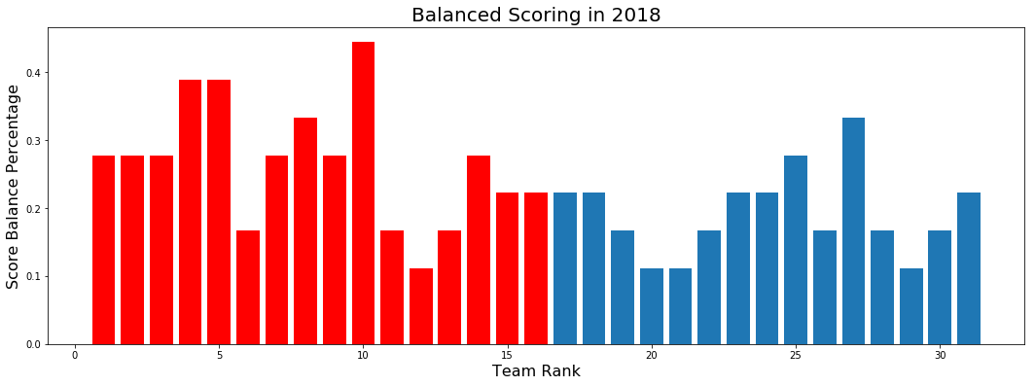
‘Balanced Scoring Stat’
Playoff teams in red

Slide 9
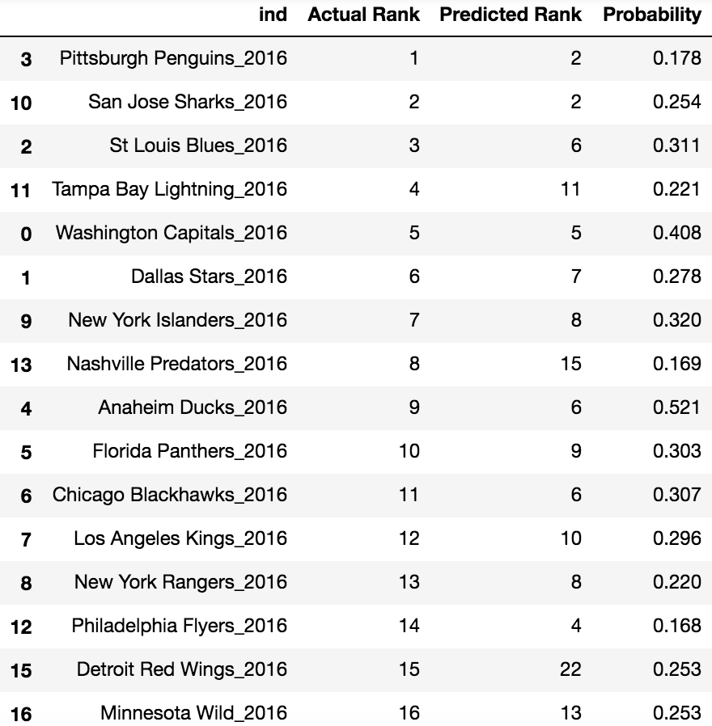
Model Best Performance: 2016 Predictions

Slide 10
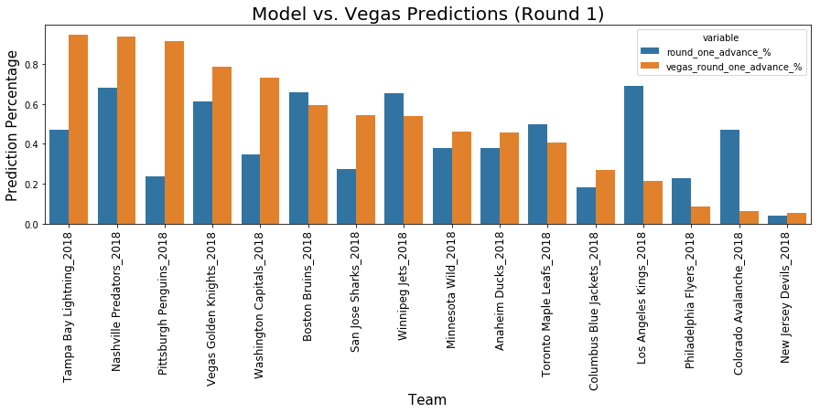
Model vs. Vegas

Slide 11
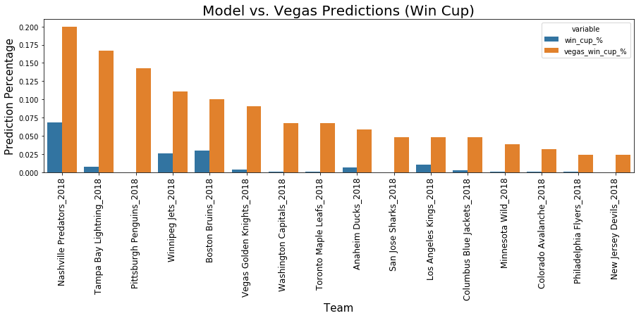
Model vs. Vegas

Slide 12
Analysis
Many of the regular season statistics available, and even the statistics I engineered, are not very good at predicting who will go far in the playoffs.
This model suffers from a class problem. Teams that win the cup are so few within the data set that the model is hesitant to make a prediction that a team will be very highly ranked.

Slide 13
Response to the Problem Statement
This classification model, as constructed, is not as predictive as I would like.
Next Steps:
- Team awareness
- Matchup Sensitivity

